Slide 1
Section 5.5
The Real Zeros of a Polynomial Function
Copyright © 2012 Pearson Education, Inc. Publishing as Prentice Hall.

Slide 2
Copyright © 2012 Pearson Education, Inc. Publishing as Prentice Hall.

Slide 3

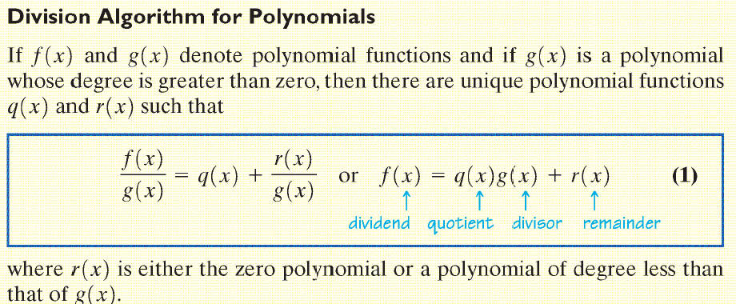
Copyright © 2012 Pearson Education, Inc. Publishing as Prentice Hall.

Slide 4

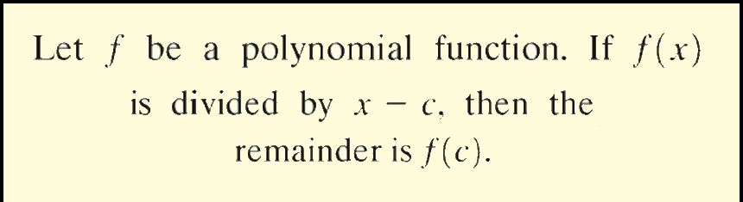
Copyright © 2012 Pearson Education, Inc. Publishing as Prentice Hall.

Slide 5

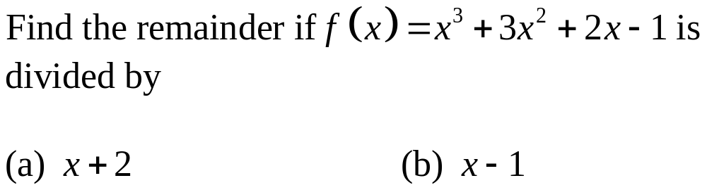
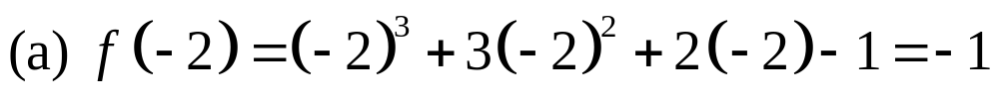
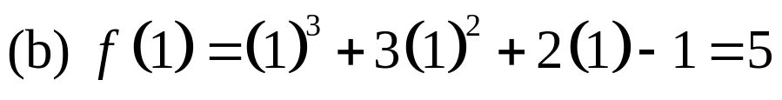
The remainder is –1.
The remainder is 5.
Copyright © 2012 Pearson Education, Inc. Publishing as Prentice Hall.

Slide 6

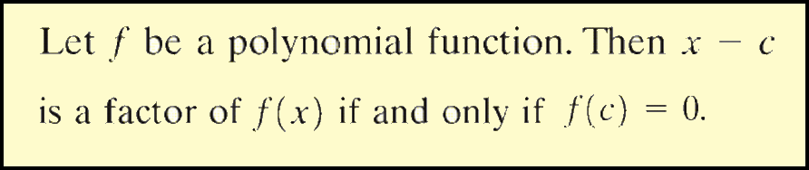
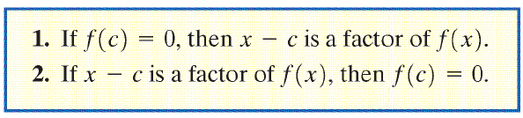
Copyright © 2012 Pearson Education, Inc. Publishing as Prentice Hall.

Slide 7
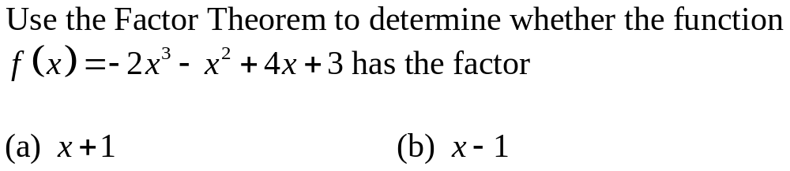
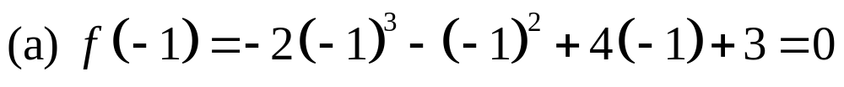
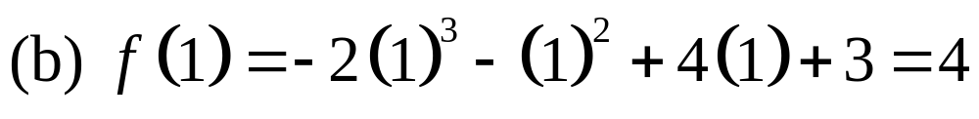
By the factor theorem, x + 1 is a factor of f(x).
By the factor theorem, x – 1 is not a factor of f(x).
Copyright © 2012 Pearson Education, Inc. Publishing as Prentice Hall.

Slide 8

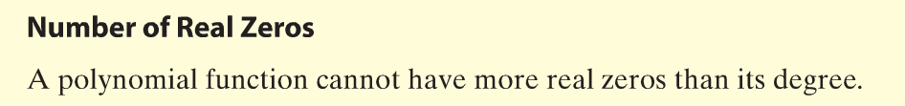
Copyright © 2012 Pearson Education, Inc. Publishing as Prentice Hall.

Slide 9
Copyright © 2012 Pearson Education, Inc. Publishing as Prentice Hall.

Slide 10

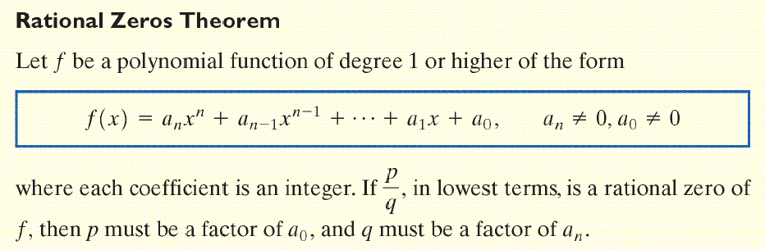
Copyright © 2012 Pearson Education, Inc. Publishing as Prentice Hall.

Slide 11
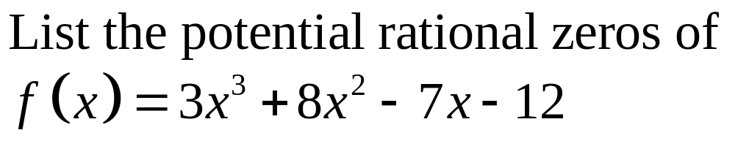
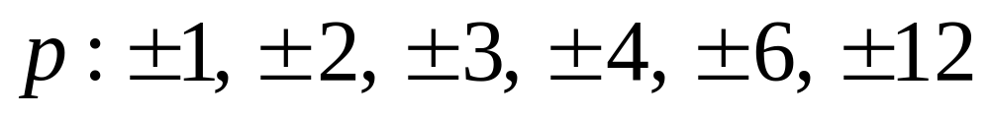
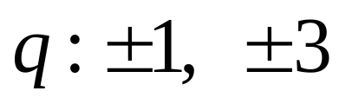
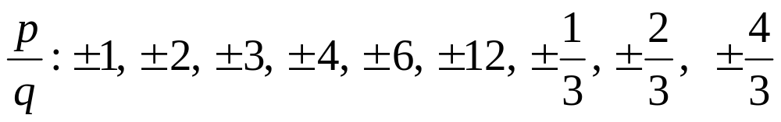
Factors of the constant
Factors of the leading coefficient
Copyright © 2012 Pearson Education, Inc. Publishing as Prentice Hall.

Slide 12
Copyright © 2012 Pearson Education, Inc. Publishing as Prentice Hall.

Slide 13
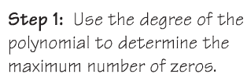
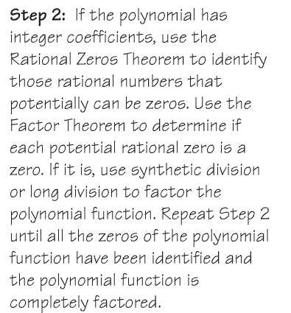
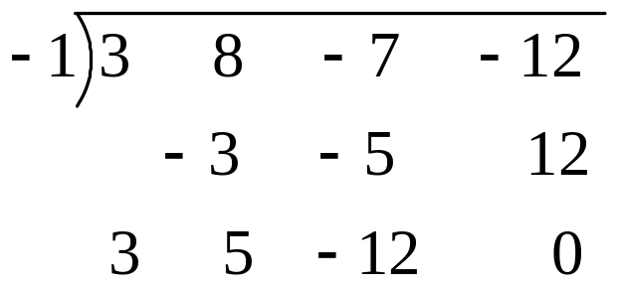
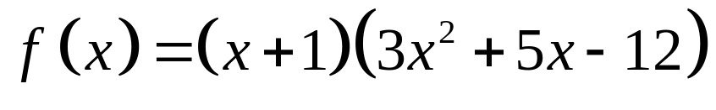
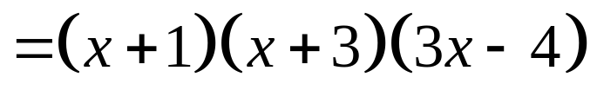
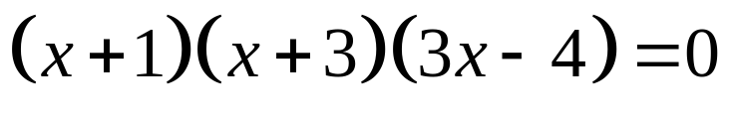
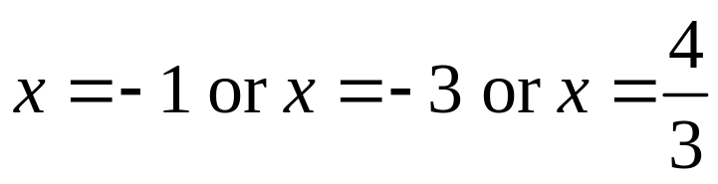
Since f is a polynomial of degree 3, there are at most three real zeros.

Slide 14
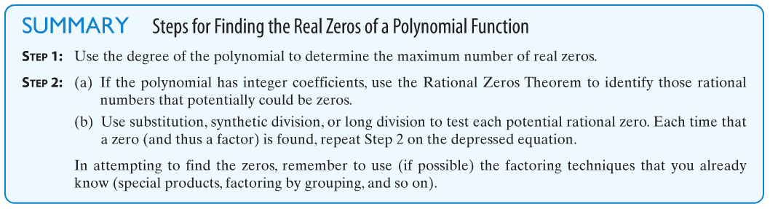
Copyright © 2012 Pearson Education, Inc. Publishing as Prentice Hall.

Slide 15
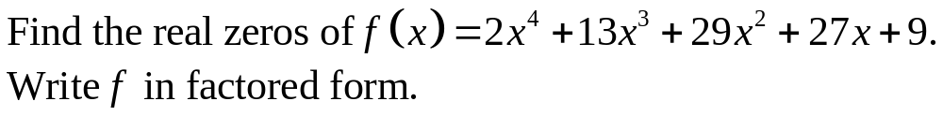
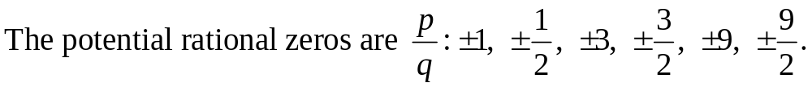
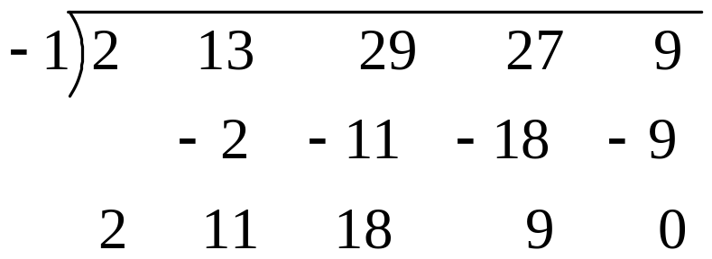
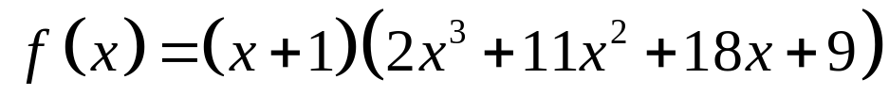
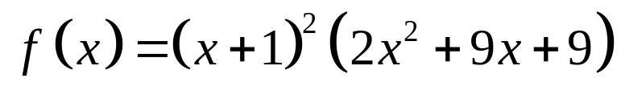
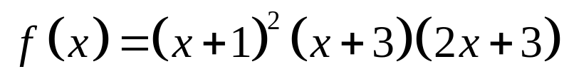
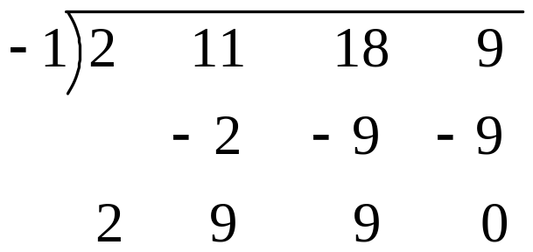
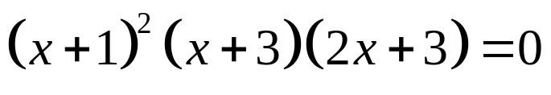
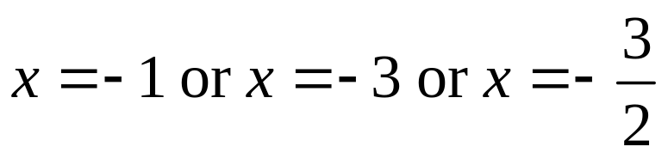
Step 1: There are at most 4 real zeros.
Step 2:
Copyright © 2012 Pearson Education, Inc. Publishing as Prentice Hall.

Slide 16

Copyright © 2012 Pearson Education, Inc. Publishing as Prentice Hall.

Slide 17
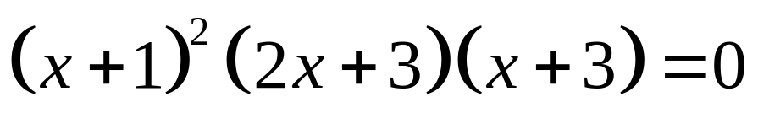
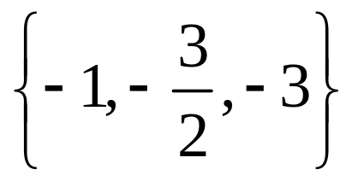
Copyright © 2012 Pearson Education, Inc. Publishing as Prentice Hall.

Slide 18

Copyright © 2012 Pearson Education, Inc. Publishing as Prentice Hall.

Slide 19
Copyright © 2012 Pearson Education, Inc. Publishing as Prentice Hall.

Slide 20


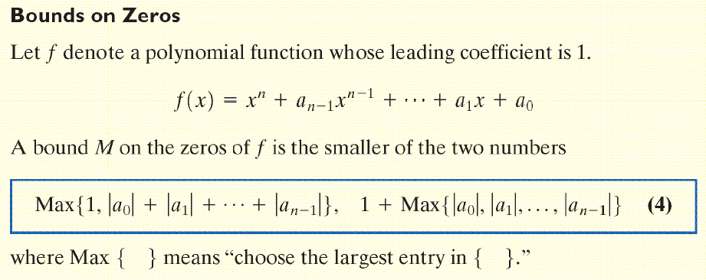
BOUND
Copyright © 2012 Pearson Education, Inc. Publishing as Prentice Hall.

Slide 21
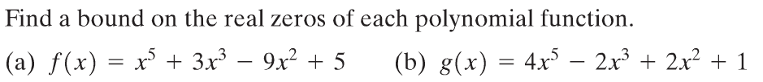
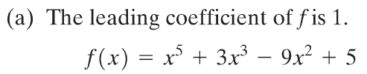


Copyright © 2012 Pearson Education, Inc. Publishing as Prentice Hall.

Slide 22
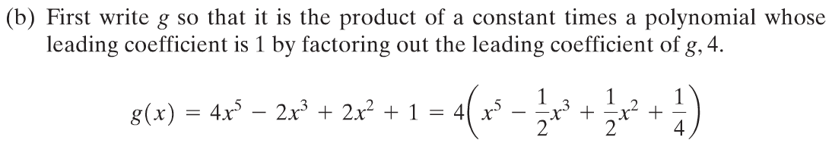



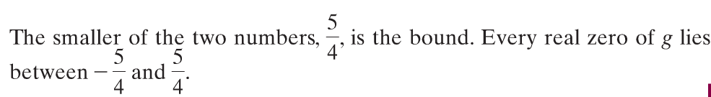

Slide 23
Copyright © 2012 Pearson Education, Inc. Publishing as Prentice Hall.

Slide 24

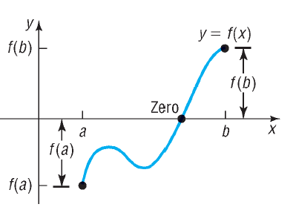
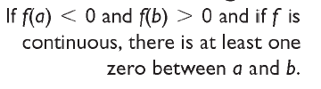
Copyright © 2012 Pearson Education, Inc. Publishing as Prentice Hall.

Slide 25
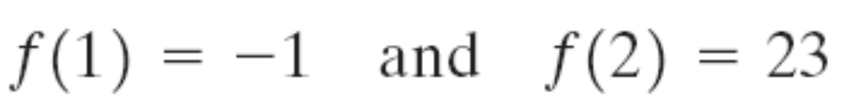
Copyright © 2012 Pearson Education, Inc. Publishing as Prentice Hall.

Slide 26
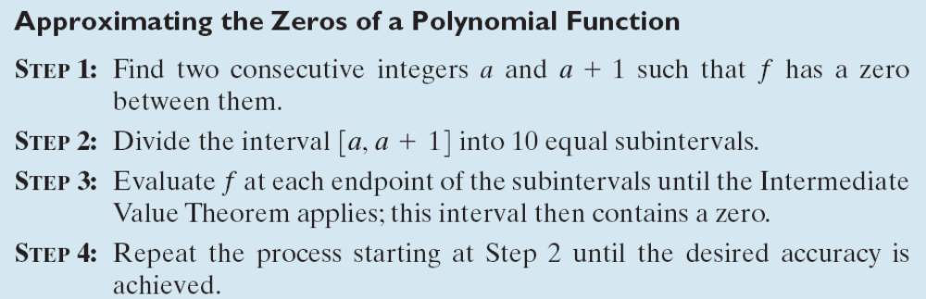
Copyright © 2012 Pearson Education, Inc. Publishing as Prentice Hall.

Slide 27
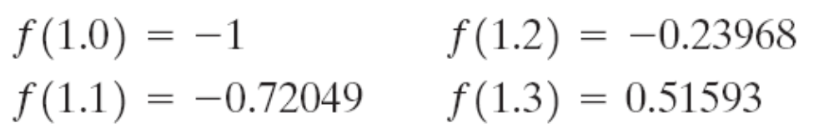
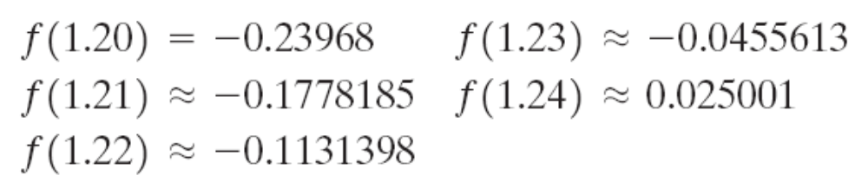
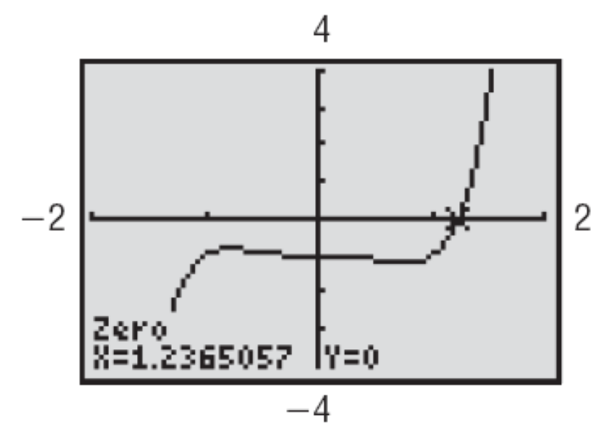
Copyright © 2012 Pearson Education, Inc. Publishing as Prentice Hall.

